Slide 1

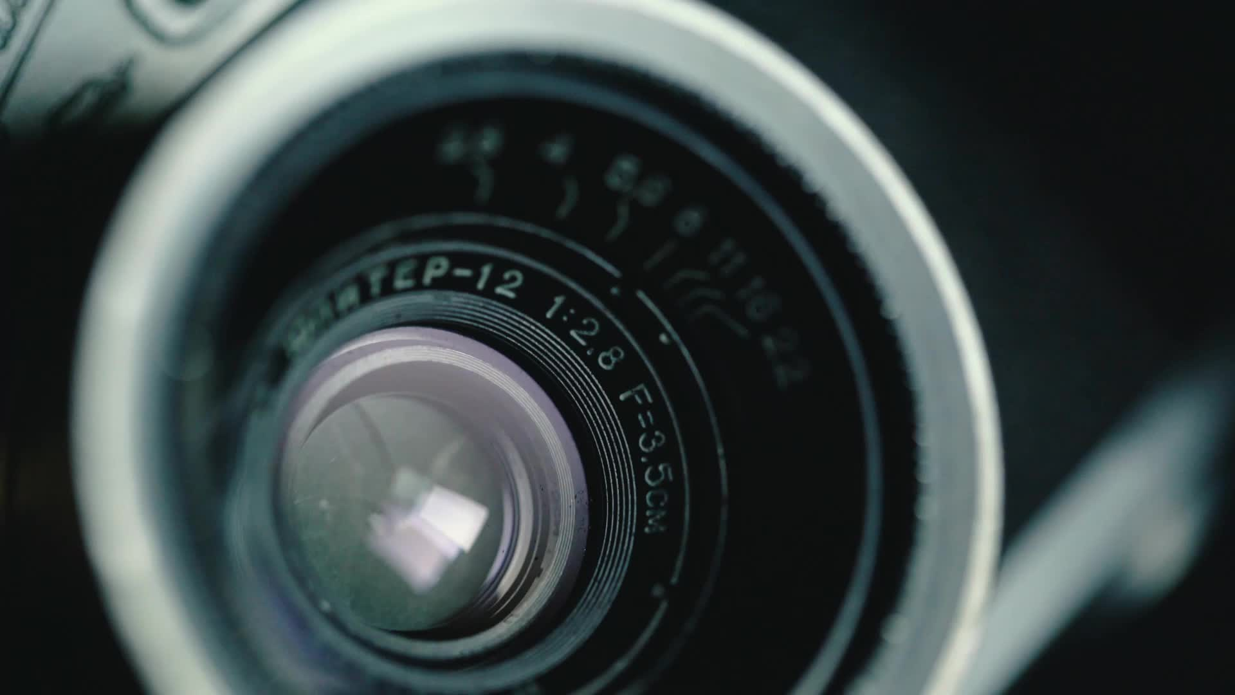
Camera
Senior Design Capstone Presentation
Fall 2025
Notes:
Alba

Slide 2
Project Purpose & Goals
Purpose:
Design and implement a compact, handheld monochrome imaging system with an internal motorized filter wheel
Goals:
Deliver high-quality, multi-wavelength capture in the field without bulky equipment or tethered laptops
Integrate filter wheel around sensor to minimize size and optical path length
Execute end-to-end capture on device with focused UI and local SD storage
Create practical research instrument for astronomy, environmental monitoring, materials analysis, and forensics
Provide superior sensitivity and detail compared to traditional color sensors
Notes:
Jon

Slide 3
Team members and Contact Information
Jonathan Scheckel - Team Lead/Optical Engineer
Mechanical Engineering, MECH5051, scheckjg@mail.uc.edu
Nate Bolin - Mechatronics Engineer
Mechanical Engineering, MECH5051, bolinns@mail.uc.edu
Alba Samsami - Software Engineer
Computer Science, CS 2258, samsamna@mail.uc.edu
Alexander Smith - Design & Prototyping Engineer
Mechanical Engineering, MECH5051, smit4a3@mail.uc.edu
Project Advisor: Dr. Jacob Cress, PE
Notes:
Jon

Slide 4

Project Abstract
A compact, handheld monochrome imaging system with an internal motorized filter wheel that delivers high-quality selective wavelength capture in the field. The monochrome sensor improves sensitivity and detail while the integrated wheel enables fast, repeatable band selection (UV/NIR/narrowband) for targeted spectral analysis. The system integrates optics, motion control, sensor, processing, UI, storage, and power into one portable device, eliminating the need for tethered laptops and external equipment typical of current systems. This practical research instrument serves astronomy, environmental monitoring, materials analysis, and forensics applications.
Notes:
Jon

Slide 5
User Stories
Wildlife Researcher: Automatically capture images when motion is detected for animal monitoring without being present
Security Officer: Review images stored on SD card for incident investigation
Hobbyist: Adjust camera angle remotely using servo motor for different views without physically moving device
System Administrator: Operate camera without WiFi for secure, tamper-resistant operation
Field Technician: Use display to preview images and verify system status during setup
Forensics Detective: UV imaging can reveal bruises that have recently faded and hidden fluids at crime scenes
Notes:
Alba

Slide 6
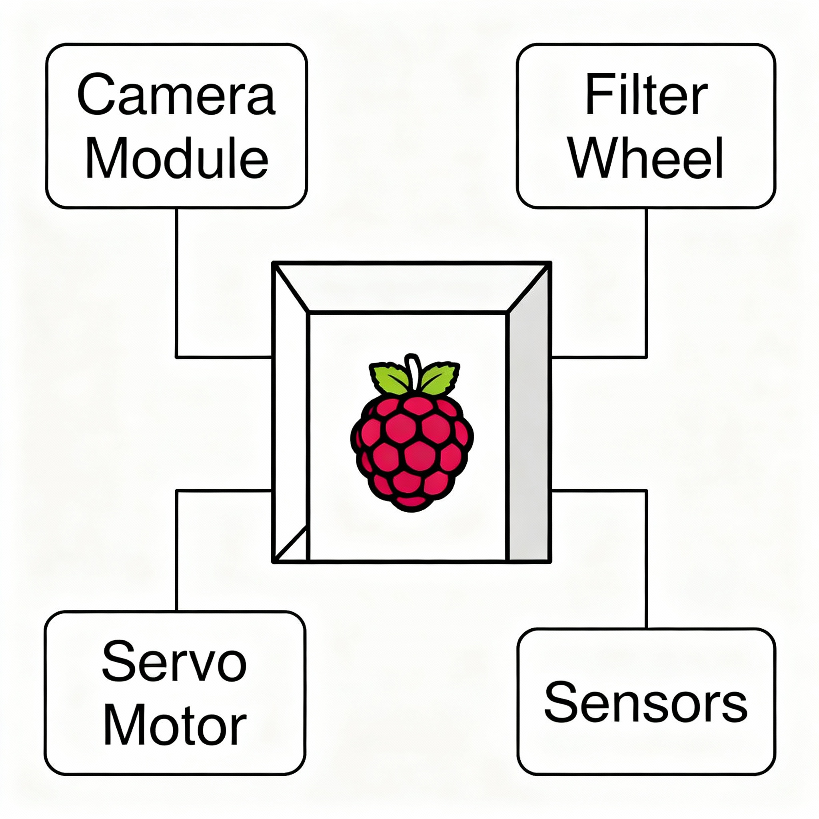
Design Diagrams
Design Architecture:
Raspberry Pi-based control system
Integrated camera module with monochrome sensor
Motorized servo for filter wheel control
Filter Wheel
Internal and external frame
Environmental sensors (light, temp)
Notes:
Alba

Slide 7
Major Project Constraints & How we overcame
Economic Constraints:
Camera components are expensive
Addressing through mechanical department purchases and entrepreneurship center grant applications
Team member certified for 1819 operations to eliminate labor costs
Professional Constraints:
Limited time and scope of senior design program
Important portfolio piece showcasing skills for post-graduation careers
Scalable design for post-graduation startup development
Market Constraints:
Niche product requiring targeted audience identification
Conveying unique value proposition through user stories
Differentiating from existing bulky lab equipment and consumer cameras
Notes:
Alex

Slide 8
Project Progress
Completed:
Planning & Proposal phase (9/22 - 10/17/2025) ✓
Conceptual design for optics train and filter wheel ✓
Early CAD designs for structure and filter wheel ✓
Current Phase:
Design phase (10/18 - 12/19/2025)
Refining filter wheel design
Developing internal and external structure models
Initial software setup (Raspberry Pi OS, Python libraries)
Initial hardware setup (Raspberry Pi, camera module, peripherals configured)
Notes:
Alba

Slide 9
Expected Accomplishments - End of Term
Complete all CAD designs: structure, filter wheel, lens mount, internal/external shell
1
Prepare comprehensive parts list for procurement
2
Initial software setup (Raspberry Pi OS, Python libraries)
3
Initial hardware setup (Raspberry Pi, camera module, peripherals configured)
4
Create detailed fabrication plans for prototyping phase
5
Ready to begin prototyping in January 2026
6
Notes:
Alex

Slide 10
Division of Work
Team Member | Primary Responsibilities | Key Tasks
Jonathan (Jon) | Team Lead, Optical Engineering | Filter wheel design, optical train, project coordination
Alexander (Alex) | Design & Prototyping | Structure design (internal/external), shell design, fabrication planning
Alba | Software Engineering | Software, implementation, parts research
Nate | Mechatronics | Electronics, internal structure, sensor integration
Notes:
Nate

Slide 11
Expected Demo at EXPO
Fully functional MVP with core capabilities
  Switching between filters from a preset program
  Combining mono images into a color image
  Compact and standalone system
Notes:
Nate
Core Capabilities
-choose certain filters or a sequence of filters
-have filter wheel move and take pictures autonomously
-have it be able to display image on a screen

